Slide 1
Webinar On Cloud migration – AWS
Presented By:-
Nitesh Kaushik

Slide 2
Contents
1. Concepts of AWS storage and database Migration
Services
2. Configuring Simple Storage Service account in
AWS for migrating Local storage to Cloud Storage
3. Configuring buckets, blobs, directories and
containers in S3 for data synchronization
4. Configuring Backup in AWS Backup
5. Configuring database migration service in AWS

Slide 3
Concepts of AWS storage
The AWS Storage Gateway is a hybrid storage service that allows your on-premises applications to seamlessly use AWS cloud storage.

Slide 4
There Are 3 Types of Cloud Storage
1. Object Storage – Applications developed within the cloud often cash in on object storage’s vast scalability and metadata characteristics. Object storage solutions like Simple Storage Service (Amazon S3) and Amazon Glacier are ideal for building modern applications from scratch that need scale and adaptability, and may even be wont to import existing data stores for analytics, backup, or archive.
2. File Storage – Many applications got to access shared files and need a filing system. this sort of storage is usually supported with a Network Attached Storage (NAS) server. File storage solutions like Elastic File System (Amazon EFS)are ideal to be used in cases like large content repositories, development environments, media stores, or user home directories.
3. Block Storage – Other enterprise applications like databases or ERP systems often require dedicated, low latency storage for every host. this is often analogous to direct-attached storage (DAS) or a cargo area Network (SAN). Block-based cloud storage solutions like Elastic Block Store (Amazon EBS) and EC2 Instance Storage

Slide 5
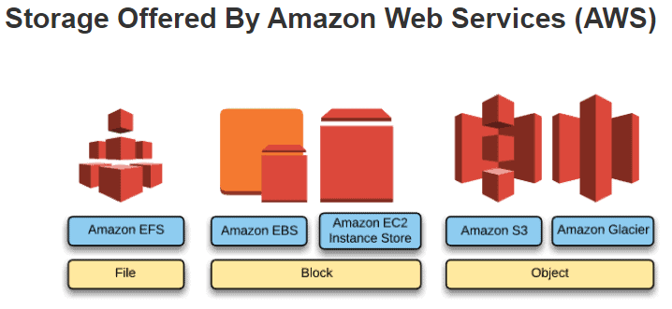

Slide 6
AWS Database Migration Service (AWS DMS) helps you migrate databases to AWS quickly and securely. The source database remains fully operational during the migration, minimizing downtime to applications that rely on the database. The AWS Database Migration Service can migrate your data to and from the most widely used commercial and open-source databases.
AWS Database Migration Service supports homogeneous migrations such as Oracle to Oracle, as well as heterogeneous migrations between different database platforms, such as Oracle or Microsoft SQL Server to Amazon Aurora. With AWS Database Migration Service, you can also continuously replicate data with low latency from any supported source to any supported target. For example, you can replicate from multiple sources to Amazon Simple Storage Service (Amazon S3) to build a highly available and scalable data lake solution. You can also consolidate databases into a petabyte-scale data warehouse by streaming data to Amazon Redshift. Learn more about the supported source and target databases.

Slide 7
You can use AWS Database Migration Service (AWS DMS) to migrate your data to and from most widely used commercial and open-source databases such as Oracle, PostgreSQL, Microsoft SQL Server, Amazon Redshift, Amazon Aurora, MariaDB, and MySQL. The service supports homogeneous migrations such as Oracle to Oracle, and also heterogeneous migrations between different database platforms, such as Oracle to MySQL or MySQL to Amazon Aurora MySQL-Compatible Edition. The source or target database must be on an AWS service.

Slide 8
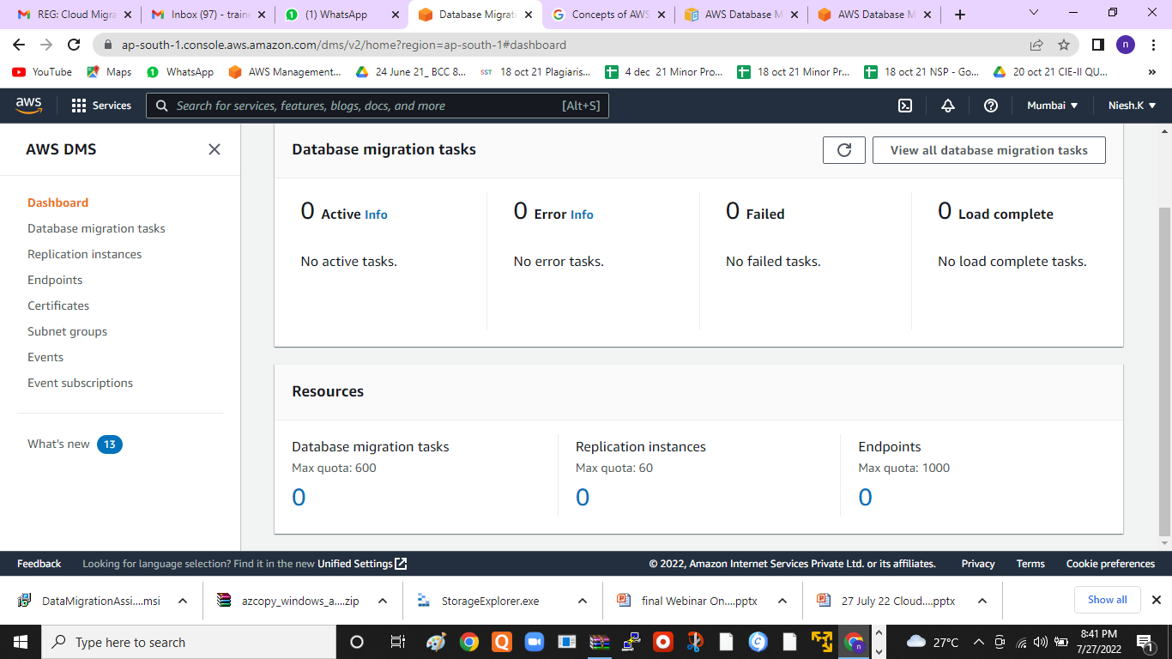

Slide 9
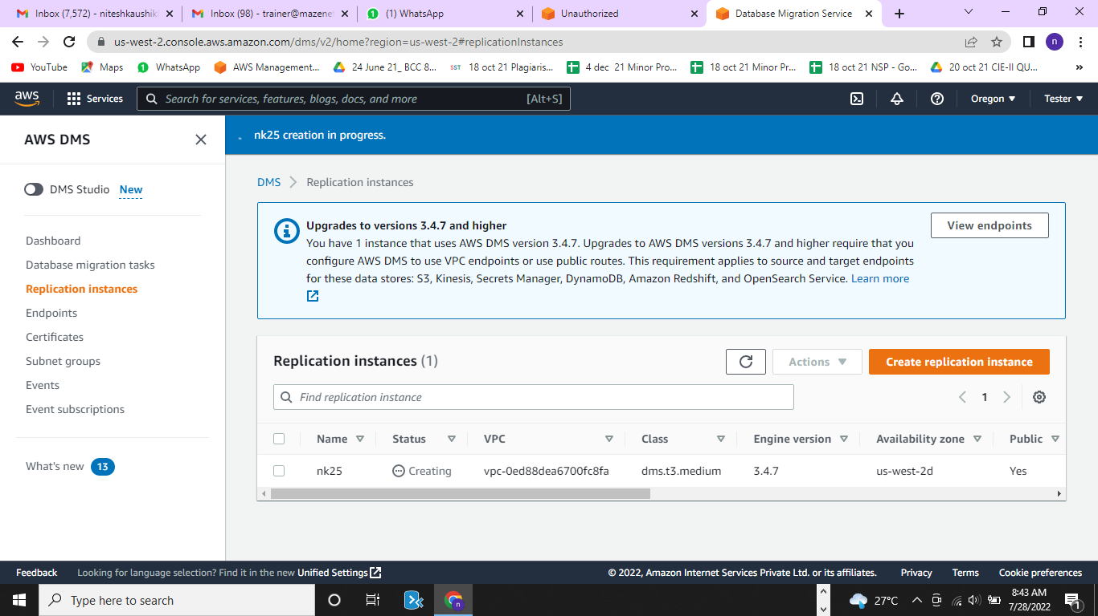

Slide 10
To create a migration task
Sign in to the AWS Management Console and open the AWS DMS console at https://console.aws.amazon.com/dms/v2/.
If you are signed in as an AWS Identity and Access Management (IAM) user, make sure that you have the appropriate permissions to access AWS DMS. For more information about the permissions required, see IAM permissions needed to use AWS DMS.
On the navigation pane, choose Database migration tasks, and then choose Create task.
On the Create database migration task page, in the Task configuration section, specify the task options. The following table describes the settings.

Slide 11
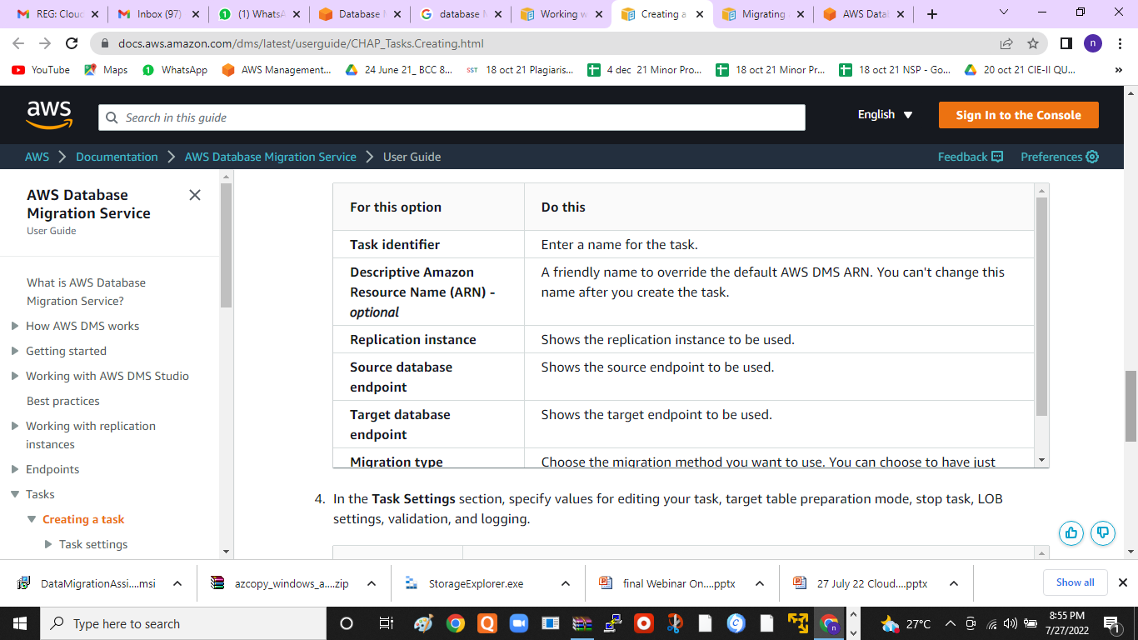

Slide 12
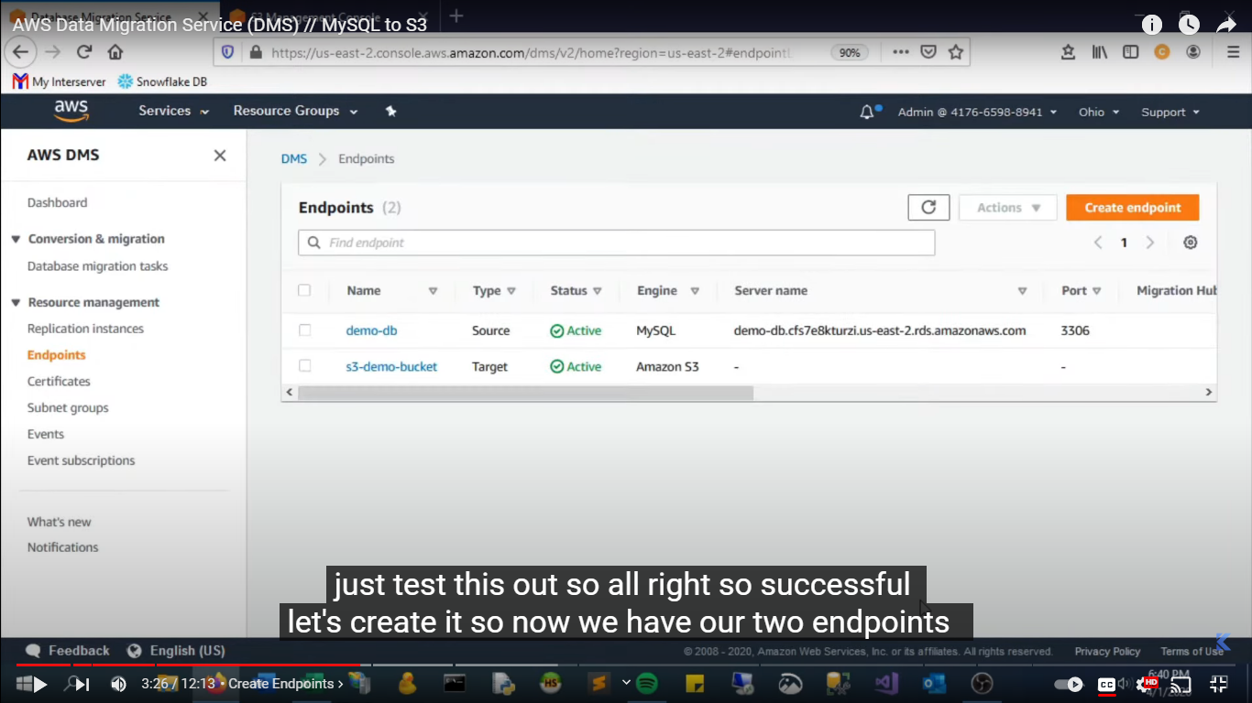

Slide 13
Benefits
Simple to use
AWS Database Migration Service is simple to use. There is no need to install any drivers or applications, and it does not require changes to the source database in most cases. You can begin a database migration with just a few clicks in the AWS Management Console. Once the migration has started, DMS manages all the complexities of the migration process including automatically replicating data changes that occur in the source database during the migration process. You can also use this service for continuous data replication with the same simplicity.
Minimal downtime
AWS Database Migration Service helps you migrate your databases to AWS with virtually no downtime. All data changes to the source database that occur during the migration are continuously replicated to the target, allowing the source database to be fully operational during the migration process. After the database migration is complete, the target database will remain synchronized with the source for as long as you choose, allowing you to switch over the database at a convenient time.
Supports widely used databases
AWS Database Migration Service can migrate your data to and from most of the widely used commercial and open source databases. It supports homogeneous migrations such as Oracle to Oracle, as well as heterogeneous migrations between different database platforms, such as Oracle to Amazon Aurora. Migrations can be from on-premises databases to Amazon Relational Database Service (Amazon RDS) or Amazon Elastic Compute Cloud (Amazon EC2), databases running on EC2 to RDS, or vice versa, as well as from one RDS database to another RDS database. It can also move data between SQL, NoSQL, and text based targets.
Low cost
AWS Database Migration Service is a low-cost service. You only pay for the compute resources used during the migration process and any additional log storage. Migrating a terabyte-size database can be done for as little as $3. This applies to both homogeneous and heterogeneous migrations of any supported databases. This is in stark contrast to conventional database migration methods that can be very expensive.
On-going replication
You can set up a DMS task for either one-time migration or on-going replication. An on-going replication task keeps your source and target databases in sync. Once set up, the on-going replication task will continuously apply source changes to the target with minimal latency. All DMS features, such as data validation and transformations, are available for any replication task.
Reliable
The AWS Database Migration Service is highly resilient and self–healing. It continually monitors source and target databases, network connectivity, and the replication instance. In case of interruption, it automatically restarts the process and continues the migration from where it stopped. Multi-AZ option allows you to have high availability for database migration and continuous data replication by enabling redundant replication instances.

Slide 14
2. Configuring Simple Storage Service account in AWS for migrating Local storage to Cloud Storage
Amazon Simple Storage Service (Amazon S3) is an object storage service that offers industry-leading scalability, data availability, security, and performance. You can use Amazon S3 to store and retrieve any amount of data at any time, from anywhere.
To get the most out of Amazon S3, you need to understand a few simple concepts. Amazon S3 stores data as objects within buckets. An object consists of a file and optionally any metadata that describes that file. To store an object in Amazon S3, you upload the file you want to store to a bucket. When you upload a file, you can set permissions on the object and any metadata.
Buckets are the containers for objects. You can have one or more buckets. For each bucket, you can control access to it (who can create, delete, and list objects in the bucket), view access logs for it and its objects, and choose the geographical region where Amazon S3 will store the bucket and its contents.

Slide 15
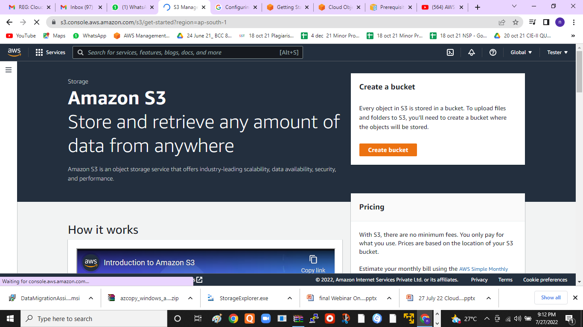

Slide 16
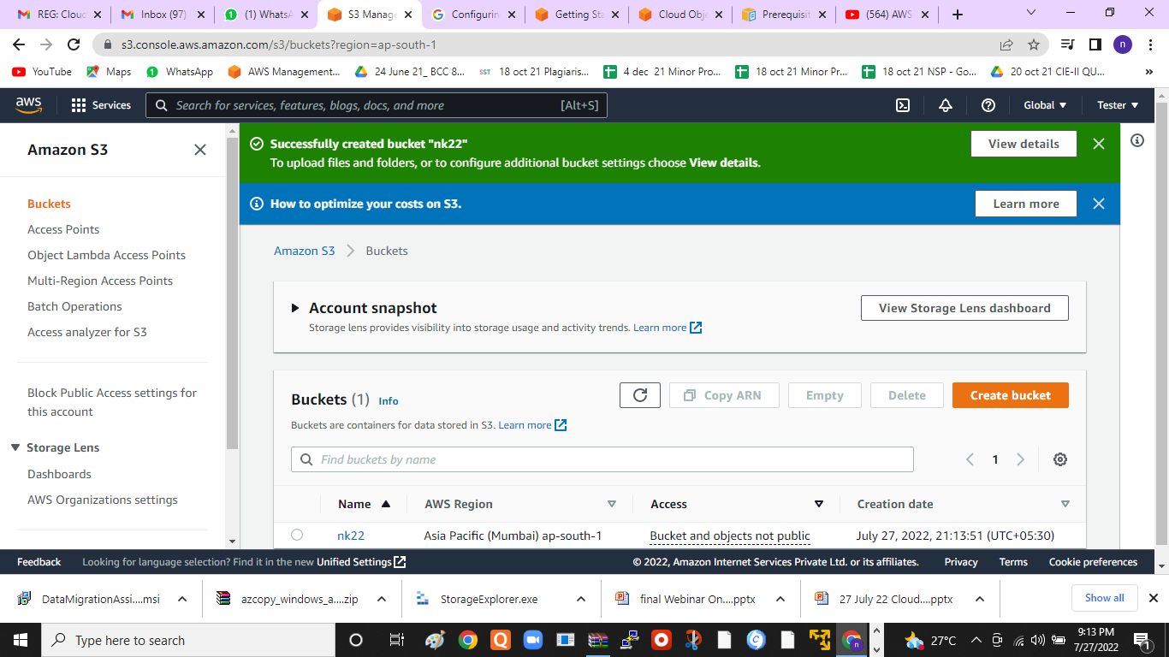

Slide 18
Step 1
Set up and log into your AWS account
To use Amazon S3, you need an AWS account . If you don't already have one, you'll be prompted to create one when you sign up for Amazon S3. You will not be charged for Amazon S3 until you use it.
Step 2
Create a bucket
Every object in Amazon S3 is stored in a bucket. Before you can store data in Amazon S3, you must create an S3 bucket

Slide 19
Step 3
Start building with AWS
Now that you've created a bucket, you're ready to add an object to it. An object can be any kind of file: a text file, a photo, a video, and so on. Read the Getting Started Guide to learn more and start building.

Slide 20
3. Configuring buckets, blobs, directories and containers in S3 for data synchronization
Buckets configured for object replication can be owned by the same or different AWS accounts and can be in the same or different AWS Regions.
Section 1: Replicating new objects between S3 buckets
S3 Replication enables automatic, asynchronous copying of objects across Amazon S3 buckets. Buckets configured for object replication can be owned by the same or different AWS accounts and can be in the same or different AWS Regions. S3 Replication can be used to copy new objects between two or more S3 buckets, and can be additionally enabled to copy existing objects. To enable S3 Replication, refer to the S3 Replication User Guide.
Estimating cost of S3 Replication
For S3 Replication (Cross-Region Replication and Same-Region Replication), you pay for replication request charges, storage charges for selected destination, and applicable infrequent access storage retrieval fees. For Cross-Region Replication (CRR), you also pay for inter-Region Data Transfer OUT from S3 to each destination Region. Additionally, when you use S3 Replication Time Control (S3 RTC), you pay a Replication Time Control Data Transfer fee.
For example, let’s assume you want to replicate data from US-west to US-east with CRR. Your bucket is comprised of 4-MB objects and the data sums up to 5 TB in size. You have 1.3 million objects in the bucket, so you will be charged replication request charges of $6.50 (request charges are $0.005 per 1000 requests). Since you are replicating data in between two AWS Regions, you will also be charged the data transfer fee of $102.4 (data transfer fee is $0.02/GB).
If your objects are encrypted with SSE-KMS, you will be charged for two KMS operations (decrypt at source and re-encrypt in destination) at a rate of $0.03 per 10,000 requests (more details on KMS charges here). For objects encrypted with SSE-KMS, consider enabling S3 Bucket Keys. S3 Bucket Keys can reduce AWS KMS request costs by up to 99 percent by decreasing the request traffic from Amazon S3 to AWS KMS. There are no additional charges for replicating data cross-account. For updated pricing on S3 Replication, please refer to the pricing FAQs under Replication here and the S3 pricing page.

Slide 21
If you are following along with this blog post, we assume that you are familiar with the following:
Amazon S3
Elastic Beanstalk
How to package Node.js packages
Additionally, it is assumed that you have valid accounts with both AWS Cloud and Azure Cloud.
Trying out this solution would incur charges to both your AWS and Azure Cloud accounts. We have included a cleanup section at the end of this post to help you avoid unnecessary charges.

Slide 22
Source data to be migrated
For the purposes of this demonstration, we are going to migrate the IMDB movies dataset to Amazon S3. The IMDb movies dataset must already be available in Azure Blob Storage, and in this case it is a JSON file. As mentioned previously, you can have other kinds of files too. We detail how this JSON file is migrated to Amazon S3 in the following sections. The following screenshot shows the previously mentioned JSON file in Azure Blob Storage:

Slide 23
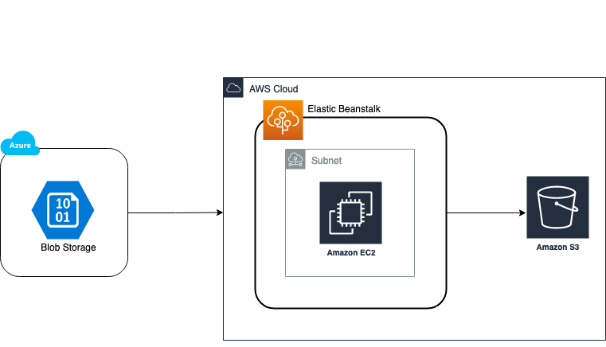

Slide 24
Setting up application
Let us dive into the details of implementing the solution step by step.
There are two main steps that are involved in achieving this solution from an implementation standpoint:
Create and bundle the Node.js package, along with the required Amazon S3 and Azure Blob storage connection details.
Deploy the bundled Node.js package in an Elastic Beanstalk worker environment.

Slide 25
Creating a Node.js package
Open up a terminal window and create an empty directory.
Navigate to the created directory, and create a package.json file by issuing an npm init command.
You are prompted to provide the following details:
Name: <<Name for your Node.js package>>.
Version: <<Initial package version number. We recommend following semantic versioning guidelines like starting with 1.0.0>>.
Main: <<This is the file that gets executed when our Node.js package gets executed. Provide name for this file Server.js>>.
Download and install the azure-blob-to-s3, inquirer, beautify, and fs node modules.
To make sure that the packages got installed without errors, run the command $npm install --save azure-blob-to-s3 inquirer beautify fs at the terminal.
Create a text file named index.js file and copy the following code in it.
#!/usr/bin/env node const inquirer = require("inquirer"); const fs = require("fs"); const beautify = require('beautify'); const enterValues = () => { const input_values = [ { name: "aws_region", type: "input", message: "Enter AWS Region:" }, { type: "input", name: "bucket_name", message: "Enter S3 Bucket Name:" }, { type: "input", name: "azure_connection", message: "Enter Azure Connection String:" }, { type: "input", name: "azure_container", message: "Enter Azure Container:" } ]; return inquirer.prompt(input_values); }; const createFile = (aws_region, bucket_name, azure_connection, azure_container) => { const code = `var toS3 = require('azure-blob-to-s3')` + `\n` + `\n` + `toS3({` + `aws: {` + `region: "${aws_region}",` + `bucket: "${bucket_name}"` + `},` + `azure: {` + `connection: "${azure_connection}",` + `container: "${azure_container}"` + `}` + `})`; const data = beautify(code, {format: 'js'}); fs.writeFile('server.js', data, function (err) { if (err) throw err; console.log('File is created successfully.'); }); }; const run = async () => { const values = await enterValues(); const { aws_region, bucket_name, azure_connection, azure_container } = values; const filePath = createFile(aws_region.trim(), bucket_name.trim(), azure_connection.trim(), azure_container.trim()); }; run(); JSON
Open a terminal window, run the command node index.js, and enter values for AWS Region, S3 bucket name, Azure connection String, and Azure container. On successful execution, you should see a Server.js file created in the folder.
To make a zip file, compress the server.js, package.json, and package-lock.json files. We upload this zip file while we are creating an Elastic Beanstalk worker environment detailed in the following steps.

Slide 26
Creating a Node.js package
Open up a terminal window and create an empty directory.
Navigate to the created directory, and create a package.json file by issuing an npm init command.
You are prompted to provide the following details:
Name: <<Name for your Node.js package>>.
Version: <<Initial package version number. We recommend following semantic versioning guidelines like starting with 1.0.0>>.
Main: <<This is the file that gets executed when our Node.js package gets executed. Provide name for this file Server.js>>.
Download and install the azure-blob-to-s3, inquirer, beautify, and fs node modules.
To make sure that the packages got installed without errors, run the command $npm install --save azure-blob-to-s3 inquirer beautify fs at the terminal.
Create a text file named index.js file and copy the following code in it.

Slide 27
#!/usr/bin/env node const inquirer = require("inquirer"); const fs = require("fs"); const beautify = require('beautify'); const enterValues = () => { const input_values = [ { name: "aws_region", type: "input", message: "Enter AWS Region:" }, { type: "input", name: "bucket_name", message: "Enter S3 Bucket Name:" }, { type: "input", name: "azure_connection", message: "Enter Azure Connection String:" }, { type: "input", name: "azure_container", message: "Enter Azure Container:" } ]; return inquirer.prompt(input_values); }; const createFile = (aws_region, bucket_name, azure_connection, azure_container) => { const code = `var toS3 = require('azure-blob-to-s3')` + `\n` + `\n` + `toS3({` + `aws: {` + `region: "${aws_region}",` + `bucket: "${bucket_name}"` + `},` + `azure: {` + `connection: "${azure_connection}",` + `container: "${azure_container}"` + `}` + `})`; const data = beautify(code, {format: 'js'}); fs.writeFile('server.js', data, function (err) { if (err) throw err; console.log('File is created successfully.'); }); }; const run = async () => { const values = await enterValues(); const { aws_region, bucket_name, azure_connection, azure_container } = values; const filePath = createFile(aws_region.trim(), bucket_name.trim(), azure_connection.trim(), azure_container.trim()); }; run();

Slide 28
Open a terminal window, run the command node index.js, and enter values for AWS Region, S3 bucket name, Azure connection String, and Azure container. On successful execution, you should see a Server.js file created in the folder.
To make a zip file, compress the server.js, package.json, and package-lock.json files. We upload this zip file while we are creating an Elastic Beanstalk worker environment detailed in the following steps.

Slide 29
Deploy Node.js package in AWS Elastic Beanstalk
Navigate to the Elastic Beanstalk console, and choose Create New Application. Provide an application name and an appropriate description for your application, then choose the Create button:

Slide 30
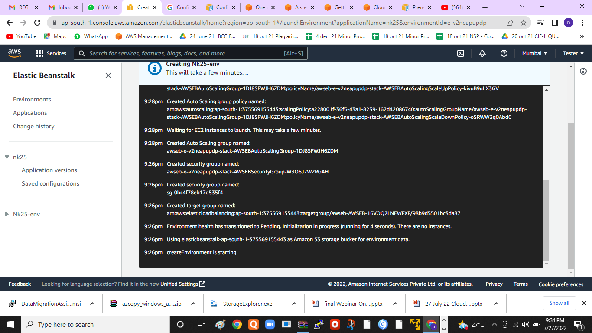

Slide 31
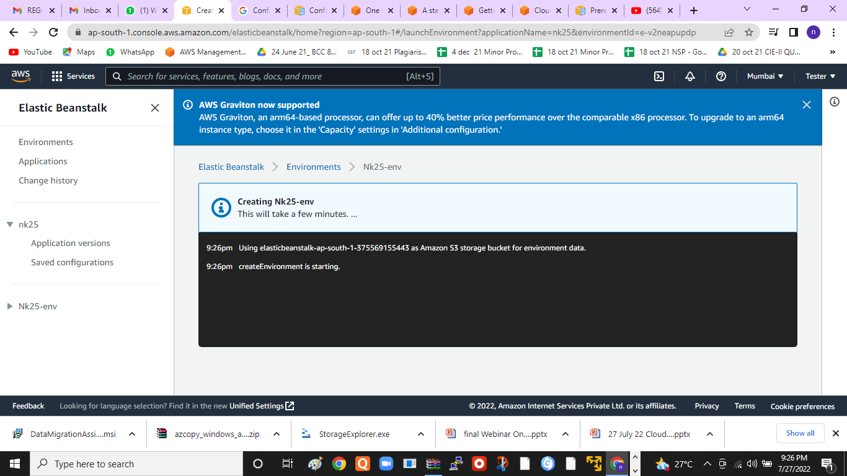

Slide 32
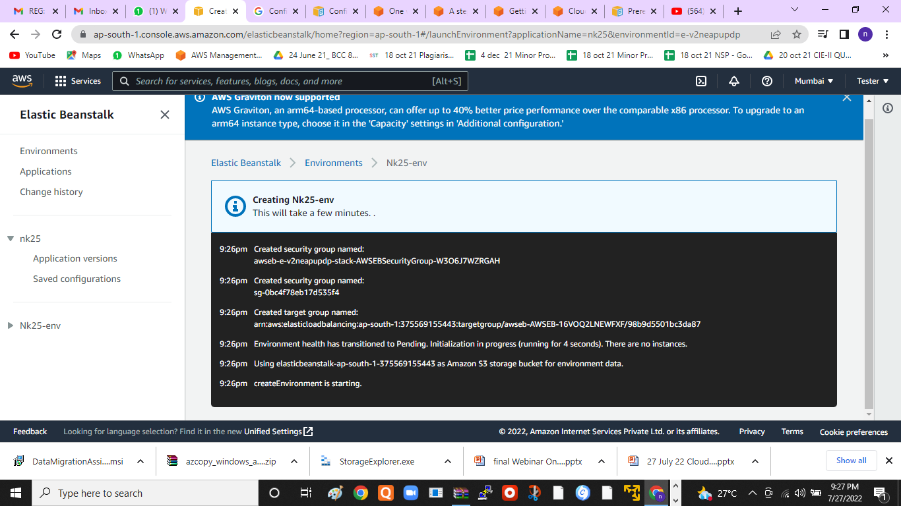

Slide 33


Slide 34
Section 2: Replicating existing objects between S3 buckets
If your bucket has new and existing data to be replicated, it’s best to configure existing object replication. You can enable existing object replication by contacting AWS Support. Once support for replication of existing objects has been enabled for the AWS account, you will be able to use S3 Replication for existing objects, in addition to newly uploaded objects. Existing object replication is an extension of the existing S3 Replication feature and includes all the same functionality. This includes the ability to replicate objects while retaining metadata (such as object creation date and time), replicate objects into different storage classes, and maintain object copies under different ownership. Existing object replication has a different timeline than new object replication, and can take some time. Time estimates will differ based on size of data to be replicated, object count, if objects are encrypted, and Region pairs for data transfer. Refer to this blog post for more details on existing object replication.
Note that existing object replication will not replicate objects that were previously replicated to or from another bucket, or have previously failed replication. If your bucket contains these types of objects, please refer to Section 3 for guidance.
Estimating cost of existing object replication
The cost to replicate existing objects is the same as replication of new objects, as explained at the bottom

Slide 35
Section 3: Compare and copy objects between S3 buckets
If your bucket has objects that have previously been replicated, or failed, and that need to be copied to the destination bucket, you will first want to identify the objects that need to be copied. In this section, we show you how to identify the objects by comparing the source and destination buckets with S3 Inventory, and then how to copy those objects using S3 Batch Operations.
Please note that copying objects is different from replication in that copying does not maintain the object metadata like version ID and creation timestamp. Later in the post, we provide a few options for performing the object copy such as a copy in place, or copy directly to the destination bucket.

Slide 36
Step 1: Compare two Amazon S3 buckets
To get started, we first compare the objects in the source and destination buckets to find the list of objects that you want to copy.
Step 1a. Generate S3 Inventory for S3 buckets
Configure Amazon S3 Inventory to generate a daily report on both buckets. Please refer to this User Guide for step-by-step instructions on how to configure S3 Inventory reports. The first daily report can take up to 48 hours to generate. Make sure to keep the following list of parameters selected:
Inventory scope: Include all versions (assuming you have S3 Versioning enabled since you have S3 Replication enabled on these buckets)
Destination bucket: Provide S3 bucket to store Inventory report

Slide 37
Step 1b. Query S3 Inventory using Amazon Athena
You can create tables for source and destination S3 Inventory reports in Amazon Athena as described in our public documentation here. Briefly, let’s understand the table schema, and then review a few example queries.
bucket (string): The name of the S3 buckets.
key (string): Object key name.
version_id (string): The version ID assigned to the object if versioning was enabled. If there is no value, then it may be because you did not set up versioning when you created the object).
is_latest (boolean): If there are multiple versions of the object, then it will show as ‘yes’ if the selected record is latest else ‘false.’
is_delete_marker (boolean): If the specific version of object was deleted, then it will be set to ‘true,’ else will be set to ‘false.’
replication_status (string): Object replication status if you set up S3 Replication. If there is no value, then it may be because you created the object before you had set up S3 Replication or while it was suspended. Refer to this documentation to understand S3 Replication status information.
Next are two of the most commonly used queries to identify differences between source and destination buckets using S3 inventory tables:
Example query 1: Get a count of objects that exist in source bucket but not in destination to give us an estimate of how much data needs to be replicated to synchronize destination with source. In this query, we compare source and destination buckets (tables) based on object key (column key of table).

Slide 38
SQL
Example query 2: Get a list of object key and version IDs that exist in the source bucket but not in the destination.
SELECT st.* FROM your-s3source-bucket-table st LEFT JOIN your-s3destination-bucket-table dt ON dt.key = st.key AND dt.version_id = st.version_id WHERE dt.key IS NULL;SQL
You can also query S3 Inventory to address few other scenarios, whether objects exist in destination but do not exist in source bucket, or to identify only the existing objects in source. The replication_status of the existing objects will be empty or null. Note, that there are a few different reasons why the source and destination Inventory reports may look different. For example, you may have different S3 Lifecycle policies on each bucket. You may also see differences if S3 Inventory was triggered at different times or if S3 Replication is still in progress in the source bucket.
If your source and destination buckets have 100M+ objects, then the S3 Inventory reports will be fairly large. You can load S3 Inventory into an Amazon Redshift database and use all of the preceding queries (from the Athena example above) to run against datasets loaded in an Amazon Redshift cluster.

Slide 39
4. Configuring Backup in AWS Backup
AWS Backup is a fully-managed service that makes it easy to centralize and automate data protection across AWS services, in the cloud, and on premises. Using this service, you can configure backup policies and monitor activity for your AWS resources in one place. It allows you to automate and consolidate backup tasks that were previously performed service-by-service, and removes the need to create custom scripts and manual processes. With a few clicks in the AWS Backup console, you can automate your data protection policies and schedules.
AWS Backup does not govern backups you take in your AWS environment outside of AWS Backup. Therefore, if you want a centralized, end-to-end solution for business and regulatory compliance requirements, start using AWS Backup today.

Slide 40
AWS Backup is a fully-managed service that makes it easy to centralize and automate data protection across AWS services, in the cloud, and on premises. Using this service, you can configure backup policies and monitor activity for your AWS resources in one place. It allows you to automate and consolidate backup tasks that were previously performed service-by-service, and removes the need to create custom scripts and manual processes. With a few clicks in the AWS Backup console, you can automate your data protection policies and schedules.
AWS Backup does not govern backups you take in your AWS environment outside of AWS Backup. Therefore, if you want a centralized, end-to-end solution for business and regulatory compliance requirements, start using AWS Backup today.

Slide 41
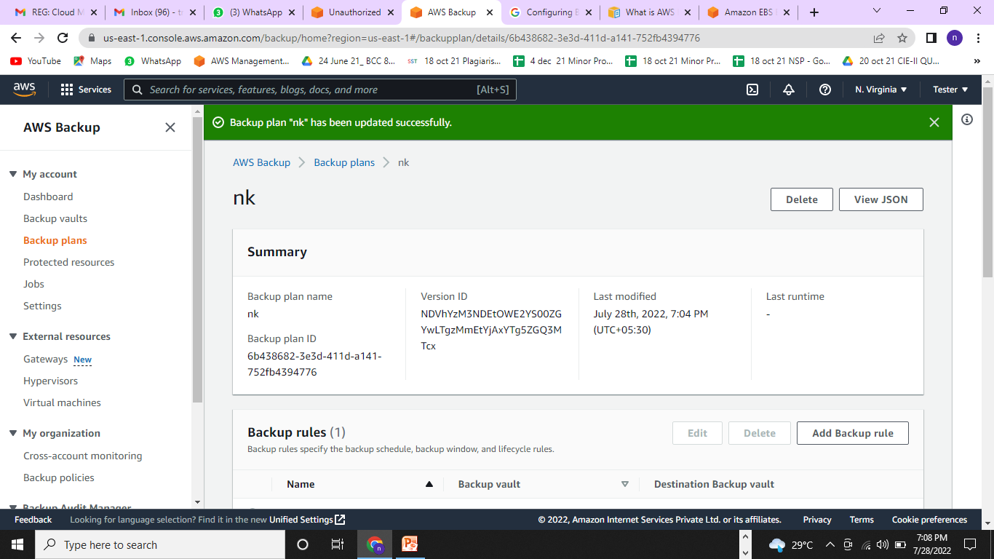

Slide 42
Using a backup plan within AWS Backup lets you automate backups using tags.
Step 1: Go to the AWS Backup console. ...
Step 2: Configure an on-demand AWS Backup job of an Amazon EC2 instance. ...
Step 3: Configure an automatic AWS Backup job of an Amazon EC2 instance. ...
Step 4: Restore an Amazon EC2 instance using AWS Backup.

Slide 43
5. Configuring database migration service in AWS
AWS Database Migration Service (AWS DMS) is a cloud service that makes it easy to migrate relational databases, data warehouses, NoSQL databases, and other types of data stores. You can use AWS DMS to migrate your data into the AWS Cloud or between combinations of cloud and on-premises setups.

Slide 44
You can use AWS Database Migration Service (AWS DMS) to migrate your data to and from most widely used commercial and open-source databases such as Oracle, PostgreSQL, Microsoft SQL Server, Amazon Redshift, Amazon Aurora, MariaDB, and MySQL. The service supports homogeneous migrations such as Oracle to Oracle, and also heterogeneous migrations between different database platforms, such as Oracle to MySQL or MySQL to Amazon Aurora MySQL-Compatible Edition. The source or target database must be on an AWS service.

Slide 45
Setting up replication for AWS Database Migration Service
Step 1: Create a replication instance using the AWS DMS console. ...
Step 2: Specify source and target endpoints. ...
Step 3: Create a task and migrate data. ...
Step 4: Test replication. ...
Step 5: Clean up AWS DMS resources.

Slide 46
To perform a database migration, take the following steps:
Set up your AWS account by following the steps in Setting up for AWS Database Migration Service.
Create your sample databases and an Amazon EC2 client to populate your source database and test replication. Also, create a virtual private cloud (VPC) based on the Amazon Virtual Private Cloud (Amazon VPC) service to contain your tutorial resources. To create these resources, follow the steps in Prerequisites for AWS Database Migration Service.
Populate your source database using a sample database creation script.
Use the AWS Schema Conversion Tool (AWS SCT) to convert the schema from the source database to the target database. To convert the schema, follow the steps in Migrate schema.
Create a replication instance to perform all the processes for the migration. To do this and the following tasks, take the steps in Replication.
Specify source and target database endpoints. For information about creating endpoints, see Creating source and target endpoints.
Create a task to define what tables and replication processes you want to use, and start replication. For information about creating database migration tasks, see Creating a task.
Verify that replication is working by running queries on the target database.

Slide 47
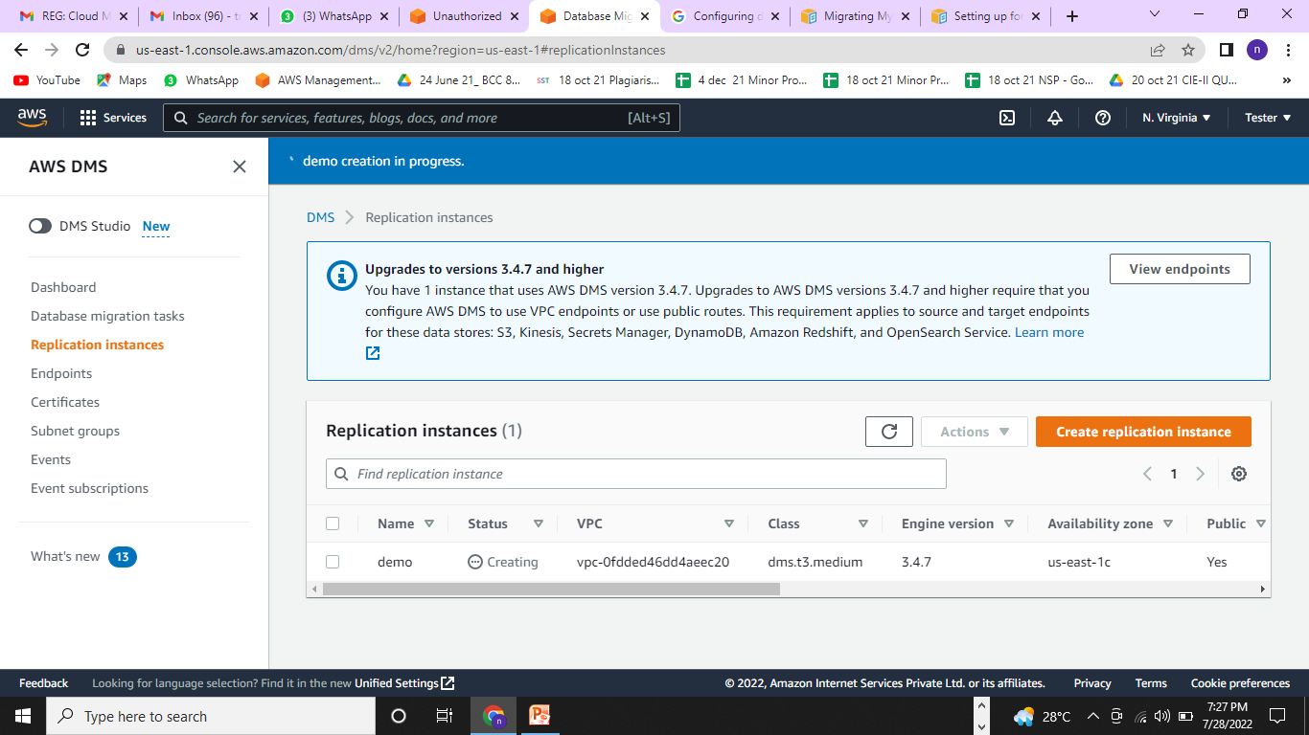

Slide 48
Thanks

